Slide 1


Construct-MON
Team
JustUsLeague
Yukthi ID – IR2025-995901

Slide 2
Problem Statement :
Workforce performance – accident gap in construction industry
The construction industry is struggling with a high number of accidents and inefficiencies, partly due to the performance gap between directly-hired and contract workers. Contract workers often exhibit passive work habits, causing project delays. This, combined with a lack of real-time health and safety monitoring, puts both the project and the workers at risk.
85%
65%
60%
20%
Directly hired workers
Contract workers

Slide 3
Our Solution: Smart Helmet System
Part 1 : the workers model
Base Module
Indian Module
Base Model: A premium helmet with a full suite of sensors (ESP32, MPU6050, DHT11, Ultrasonic Sensor, Body Temp Tracker) for maximum safety and data collection.
Indian Market Model: A cost-effective version with essential, life-saving features (ESP32, MPU6050, LED, Buzzer) to make safety technology affordable.

Slide 4
Our Solution: Smart Helmet System
Part 2 : the supervisor model
Leader Module
Computer Vision: Uses a camera to monitor worker activity and passively detect passive behavior, promoting productivity and safety.
Local SOS Alerts: Receives Bluetooth signals from team members' helmets and instantly activates its LED and buzzer, allowing the leader to respond in seconds.
Cloud Relay: Relays all data to a central dashboard, providing supervisors with a complete overview of the site's safety and productivity.

Slide 5
Our Tech:
The Brains Behind the Helmets
Part 1 : the workers model
Base Module
Indian Module
ESP 32
LED
BUZZER
DHT 11
MPU 6050
Ultrasonic Sensor
Body temperature sensor
ESP 32
LED
BUZZER
MPU 6050

Slide 6
Our Tech:
The Brains Behind the Helmets
Part 2 : the supervisor model
Leader Module
Camera Module
ESP 32
LED
Buzzer

Slide 7
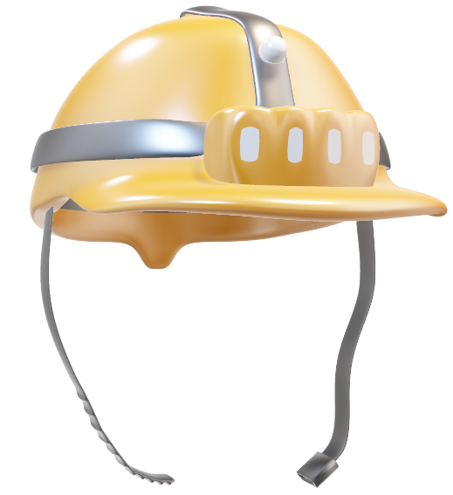
Our Prototype:
Worker Module

Slide 8
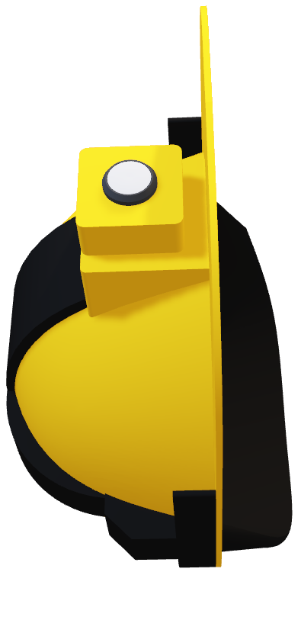
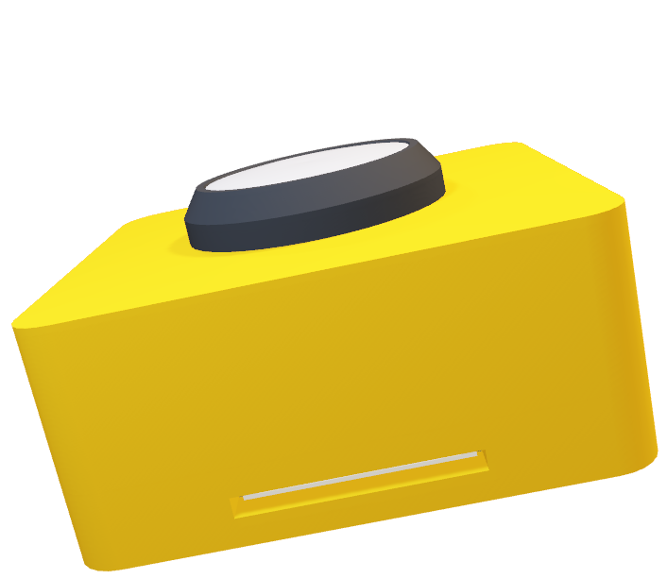
Our Prototype:
Leader Module

Slide 9
Building a Safer Tomorrow, One Helmet at a Time
Key Impacts
Real-World Use
Drastically Reduced Accidents
Enhanced productivity
Faster emergency response
Data driven decisions
Automatic SOS Dispatch
Proactive Hazard Avoidance
Real time productivity Audits
Heat stress prevention

Slide 10
The Payoff: A Safer, Smarter Tomorrow
Advanced AI & Computer Vision
Augmented Reality (AR) Integration
Broader Use Cases
Predictive Analytics: The system will evolve to use machine learning to predict potential accidents before they happen. By analyzing data on worker behavior, environmental conditions, and past incidents, it can identify high-risk situations and alert supervisors proactively.
Behavioral & Ergonomic Analysis: More advanced computer vision models can monitor and analyze a worker's movements for signs of fatigue, improper lifting techniques, or awkward postures that could lead to injury over time.
Heads-Up Display (HUD): The leader's helmet will incorporate an AR display that overlays critical information directly into their field of view. This could include real-time health data for their team, navigation to a distressed worker, or step-by-step instructions for a complex task.
On-Site Visuals: AR can be used to highlight safety hazards, mark off restricted zones, or display building schematics over a physical structure, making the job site smarter and safer.
Mining: The helmets can be equipped with gas sensors to detect dangerous fumes and provide real-time air quality monitoring in underground tunnels.
Oil & Gas: Workers can be monitored for fatigue and exposure to hazardous materials in remote and isolated environments.
Manufacturing: The system can be used to ensure workers are following proper safety procedures around heavy machinery and to monitor for repetitive strain injuries.

Slide 11
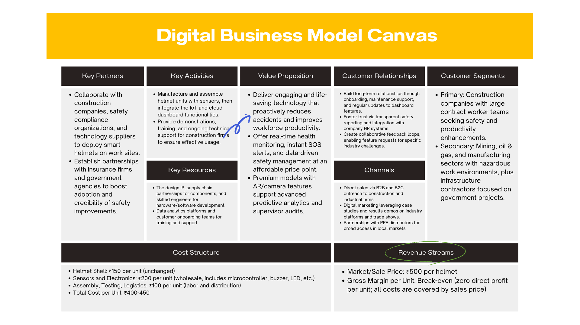

Slide 12
Conclusion
Our Smart Helmet System offers a revolutionary, two-tiered approach to worker safety and productivity. From the full-featured Base Model to the cost-effective Indian Market version, each worker's helmet provides vital health monitoring and instant SOS alerts.
The Leader's Helmet acts as an on-site command center, leveraging computer vision to boost productivity and ensure rapid response to emergencies via local Bluetooth alerts, while seamlessly relaying all data to a central cloud dashboard.
This integrated solution doesn't just protect; it empowers proactive site management, transforming construction into a safer, more efficient industry, one smart helmet at a time.

Slide 13
Thank You
Team JustUs League
Abishek Guru
Shreya Agarwal
Rajorshi Basu
Rahul Ravikumar
Kaustubh Shenoy A
I am batman

